Slide 1

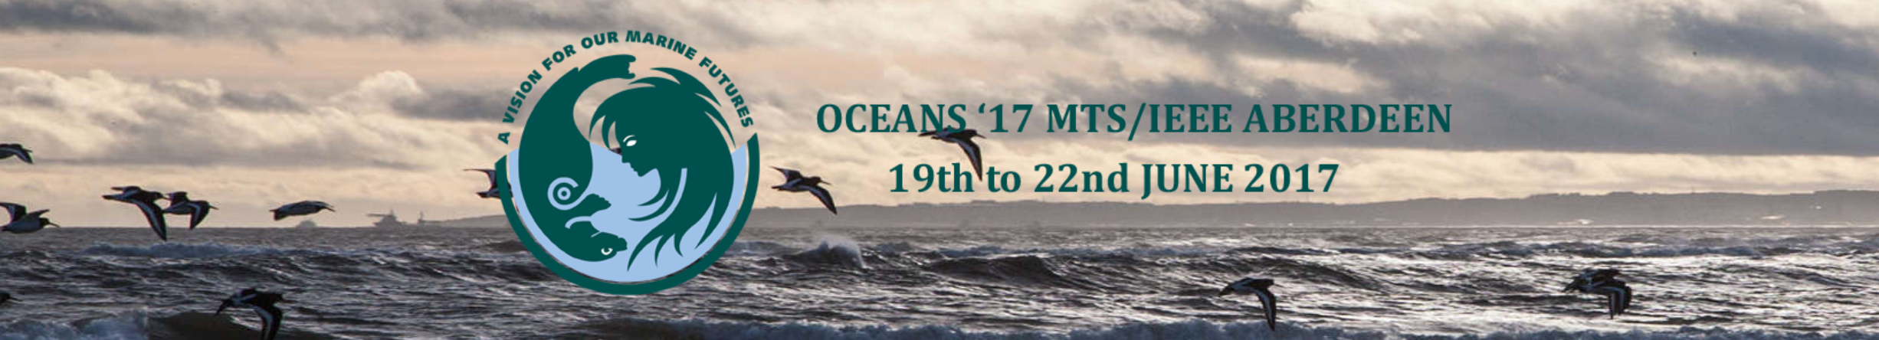

OceanRoads: Fishing Area Separation and Relation Discovery through VMS Trace Analysis
${\text{Feng} \text{Hong}}^{1}$, ${\text{Yong} \text{Zhen}}^{1}$, ${\text{Yuan} \text{Zong}}^{1}$, ${\text{Yuan} \text{Feng}}^{1∗}$, ${\text{Haiguang} \text{Huang}}^{2}$, ${\text{Hao} \text{Wang}}^{3}$, ${\text{Zhongwen} \text{Guo}}^{1}$
Ocean University of China, Qingdao
2. Wenzhou Ocean and Fishery Vessel Safety Rescue Information Center, China
3. Norwegian University of Science and Technology
Notes:
Ladies and Gentlemen, Good afternoon.
I am Dr. Feng Hong. I am honored to present our research on VMS trace analysis on behalf of our research team.

Slide 2
Outline
Background
Motivation
Problem & Challenge
Methods
Data & Results
Conclusion
Notes:
This is the outline of my presentation.

Slide 3




Background
VMS traces of one fishing vessel captured by Beidou (China satellites)
Quantified Analysis on Fishing
Notes:
As we know, Vessel Monitoring System records the trajectory of vessels. This provides the opportunity to perform quantified analysis on Fishing.

Slide 4
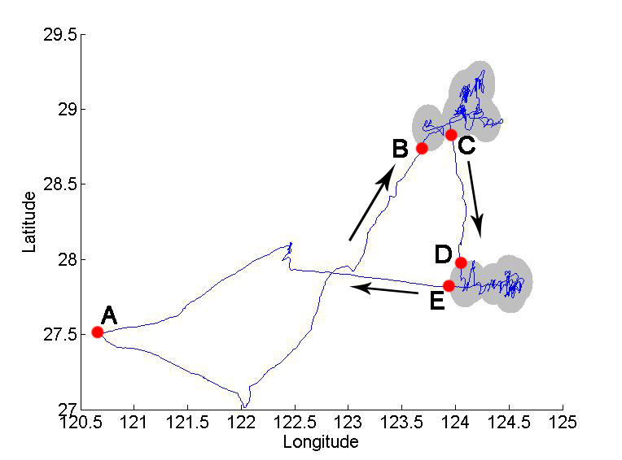
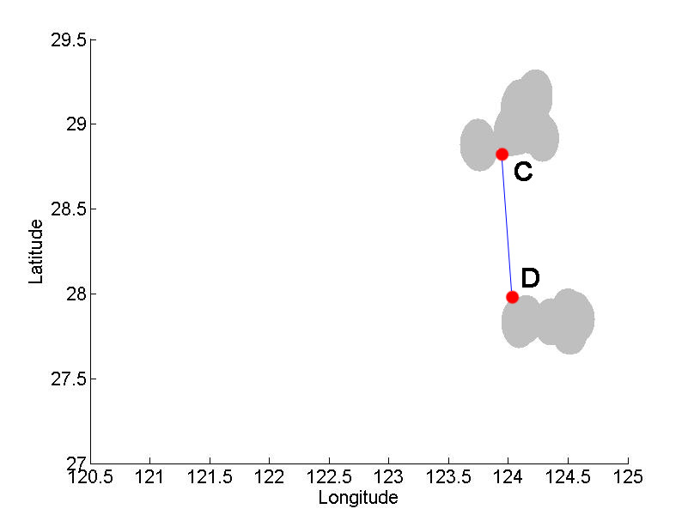
Recognition of Fishing
Zong Y, Huang H, Hong F, et al. Recognizing fishing activities via VMS trace analysis based on Mathematical Morphology[C]//Techno-Ocean (Techno-Ocean). IEEE, 2016: 465-470.
Notes:
Our previous research exploit image processing method to recognize the fishing behavior out of VMS traces. For example, we got two fishing regions and one sailing segment from the left trajectory.
Please note that the sailing segments are getting after fishing area recognition, which will play an important role on the following research.

Slide 5
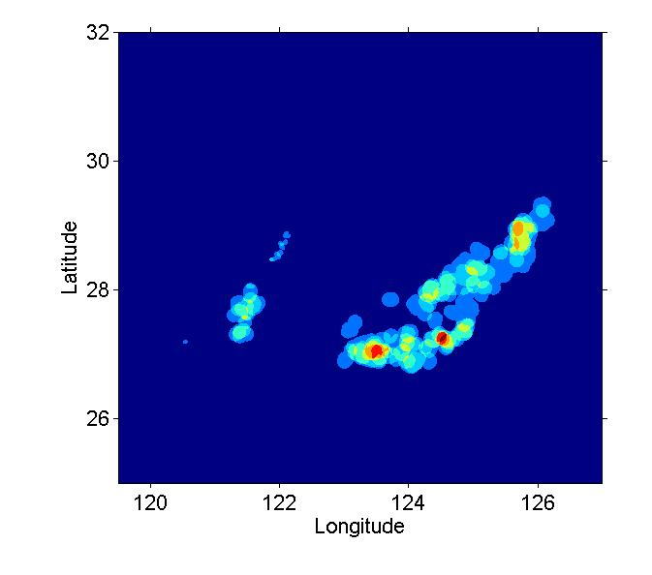
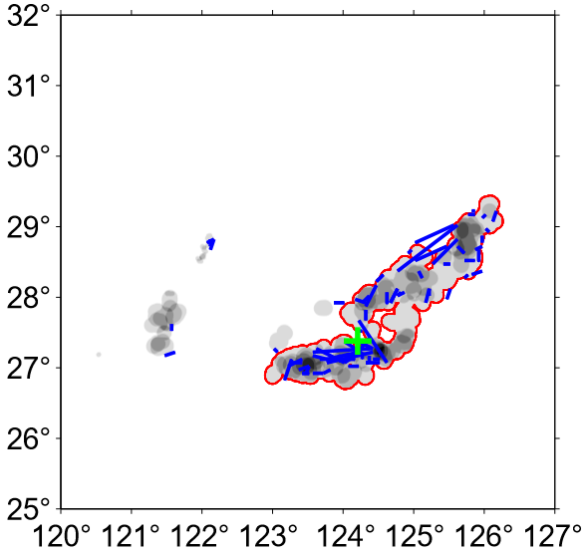
Motivation: roads & blocks
Fishing Heat Map
Fishing Heat Map + Sailing Segments
2nd Quarter, 2014
Notes:
When adding all the fishing regions together, a fishing heat map is created for resource management.
But some important fishing properties has been buried under this map.
One question is, whether fishermen treat this area as a whole or some spilt fishing regions?
Another question is, how does the vessel traverse from one fishing region to another?
Making a metaphor to land traffic scenario, the regions are the blocks while the segments are the roads linking the blocks.
The clue to answer these questions is to add the sailing segment on the heat map.
A sailing segment inside one fishing area indicates that one vessel disagree to treat the whole area as one fishing region.
So we can make use of the segment distribution to separate the area further into fishing regions or blocks.

Slide 6
Problem & Challenges
Problem：Finds blocks and roads on Ocean
Split one area to fit the segments?
Eliminate the segments inside for they come from recognition error?
Challenges
Chick or Egg Dilemma
Segments depends on fishing area recognitions
Fishing region splitting depends on the segment distributions
Fishing area & segment recognition come from single vessel trace
Solution: Let the segments (fisherman) vote!
Notes:
The research question is how to find blocks and roads.
Unlike the land scenarios, however, there are no pre-existed routes in oceans like on land to deﬁne the blocks.
The challenge here is a chicken or egg dilemma.
Because both segments and fishing area recognition come from individual fishing vessel’s experience.
The Research question is: should we split the fish area further to fit the segment distributions? Or should we just eliminate the links inside one ﬁshing area as regarded as they are induced from the ﬁshing activity recognition error?

Slide 7
Methods by Example
Layers near the fishing heat of 25% (2nd Quarter, 2014)
Lower
Upper
Notes:
We take one part of the heat map as a example.
The break point for above questions lie in the consecutive layers

Slide 8
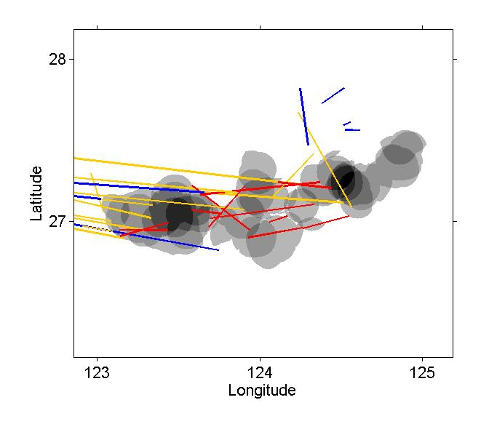
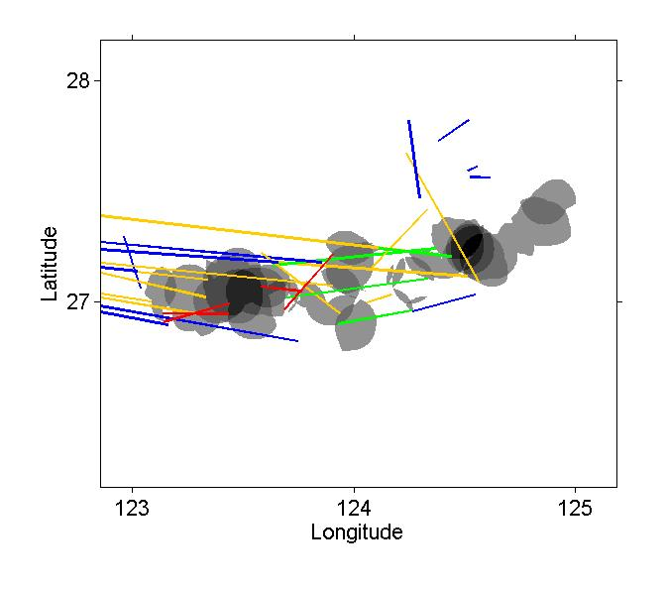
Relations between areas & segments
Lower layer
Upper layer
Red：inside one area
Green: links two areas
Yellow: sails out from one area
Blue : redundancy

Slide 9
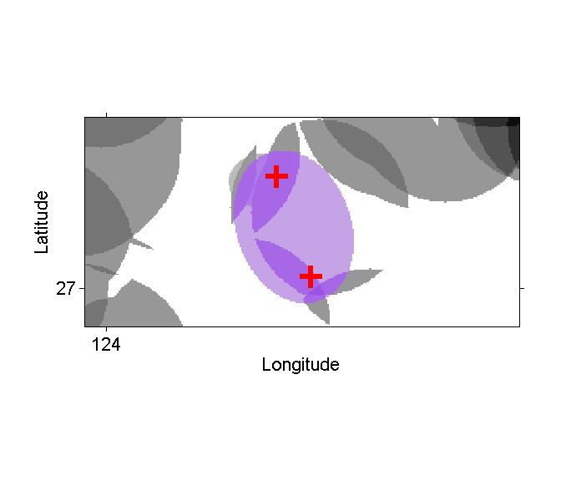
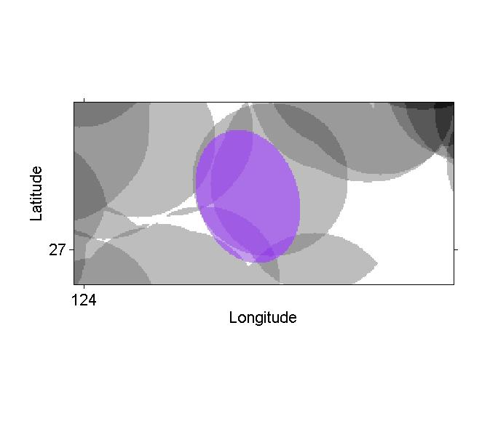
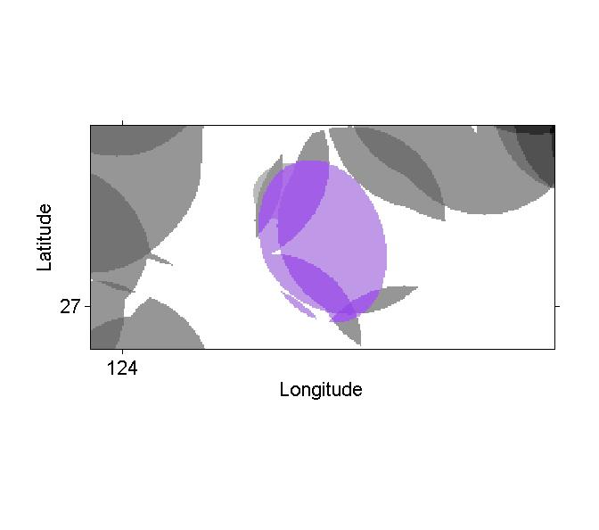
Merge Try
Ellipsoid linking
Intersection with lower layer

Slide 10

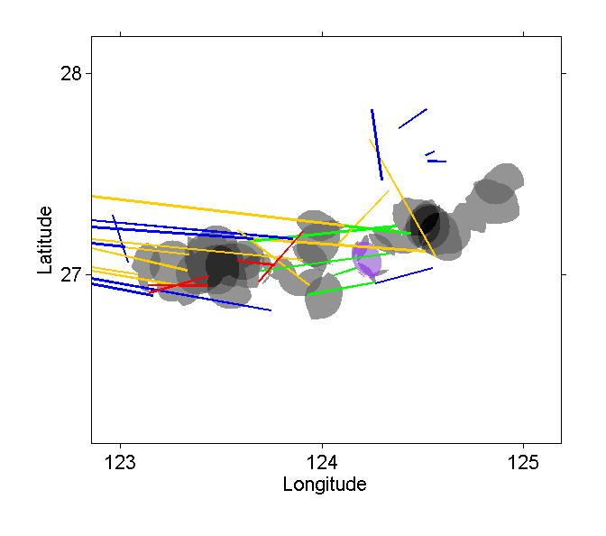
Merge?
Before Merge
After Merge

Slide 11
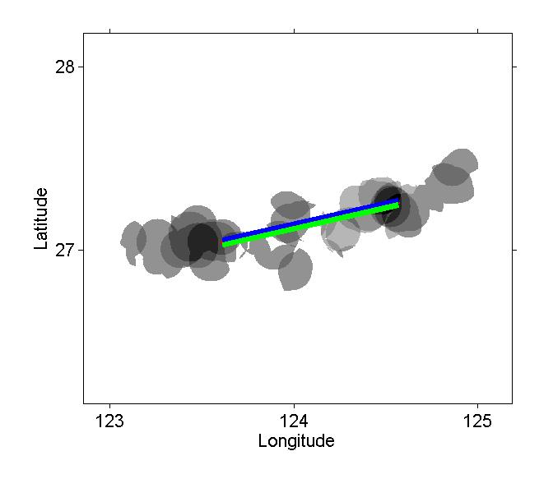
Results: Regions+Roads
Direction Color
Blue, West to East
Green, East to West

Slide 12
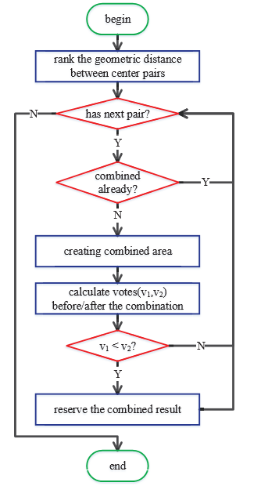
Methods Summary
Merge or not
Compares votes before and after merging
Votes
Green: 2；Red : -2；Yellow : 1；Blue : 0
How to merge
Create ellipsoid which covers the merging regions
Calculate the intersection between ellipsoid and the respond region on lower layer
Calculate roads

Slide 13

Data
Otter trawl vessels on East Sea, China
1st Apr 2014 to 30th Sep 2016
2,601,547 records in total
Zhejiang Province Ocean and Fisheries Bureau
Notes:
Our VMS data is from 34 otter trawl vessels, the duration is more than 2 years.
It contains more than 2 million records in total with a rated 60-second temporal resolution instead of a 2-hour one.
All the data is provided by the Zhejiang Province Ocean and Fisheries Bureau.

Slide 14
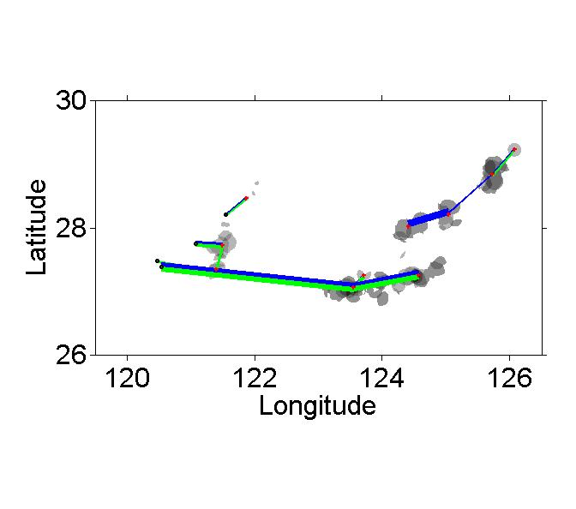
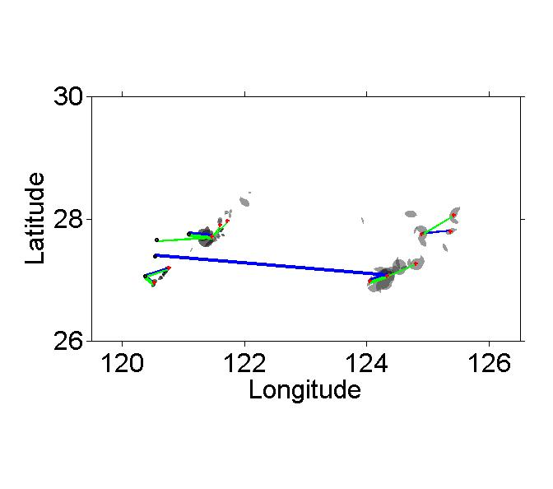
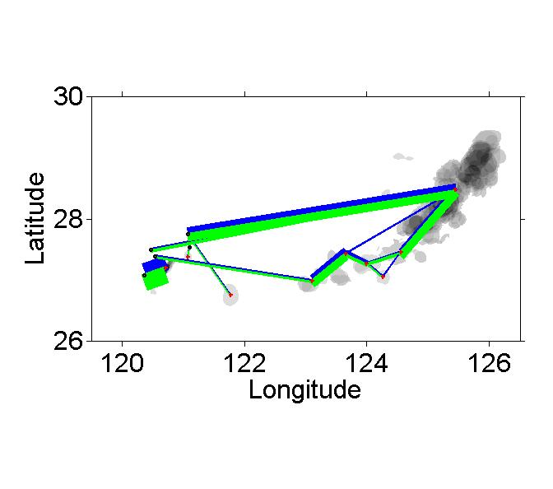
Results: 2nd Quarter
2014
2015
2016

Slide 15
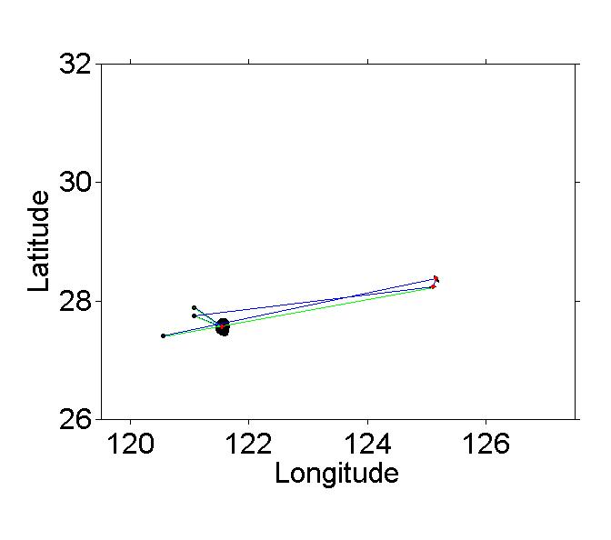
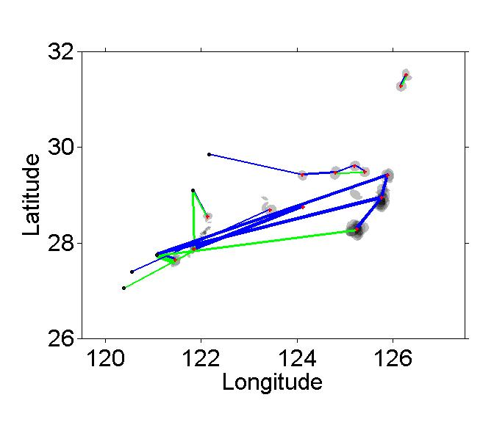
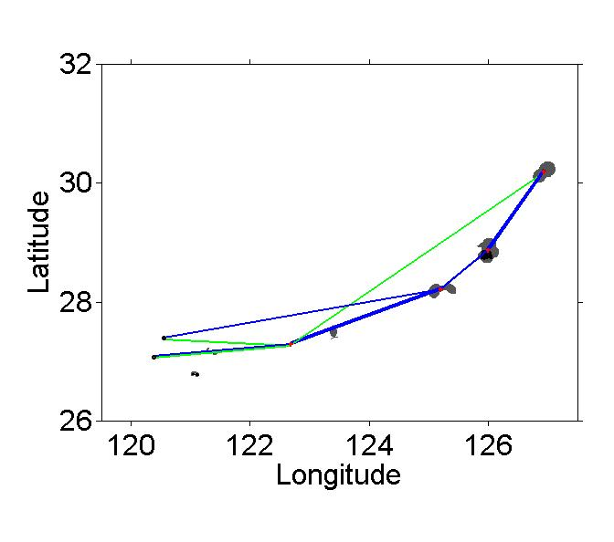
Results: 3rd Quarter
2014
2015
2016

Slide 16
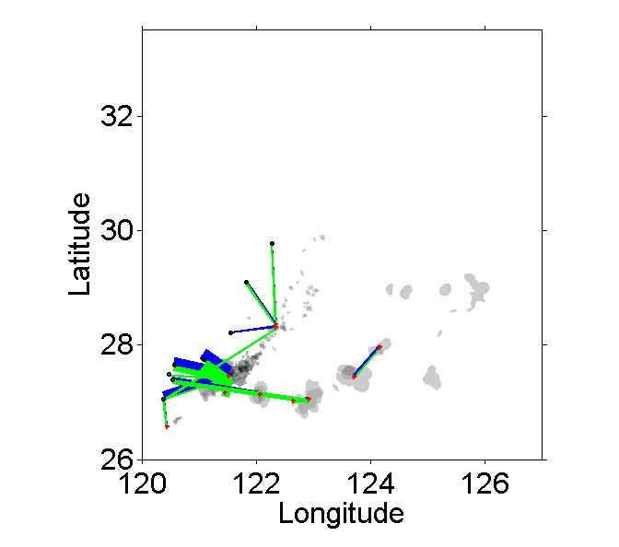
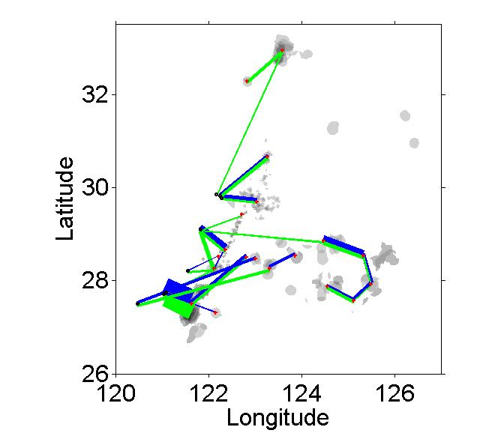
Results: 4th Quarter
2014
2015

Slide 17
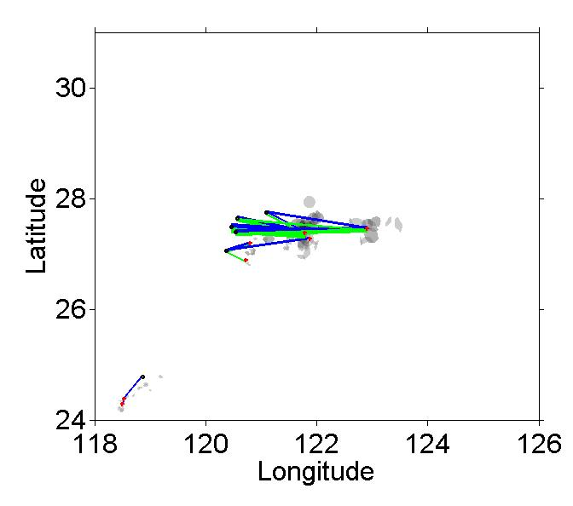
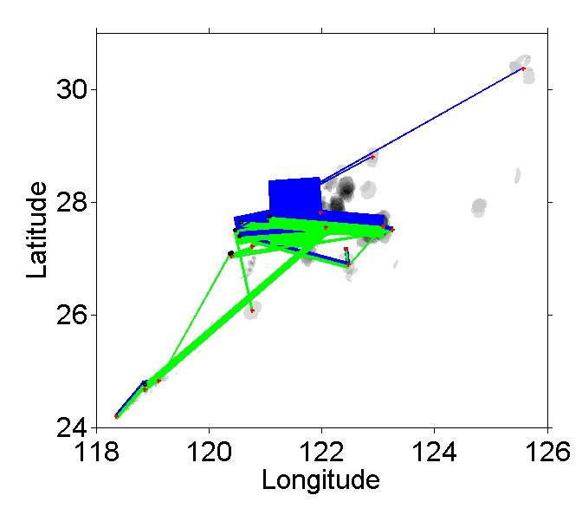
Results: 1st Quarter
2015
2016

Slide 18


Conclusions
Propose regions segmentation on fishing areas for VMS trace analysis
Determines the roads to connect fishing regions
Thanks for Your Attention！
Dr. Feng Hong,
Professor & Vice Chair
Dept. of Computer Science & Technology
Ocean University of China
http://osn.ouc.edu.cn/~hong
https://www.researchgate.net/profile/Feng_Hong

Slide 19
Heat map (1st Apr 2014 to 30th Sep 2016)

Slide 20
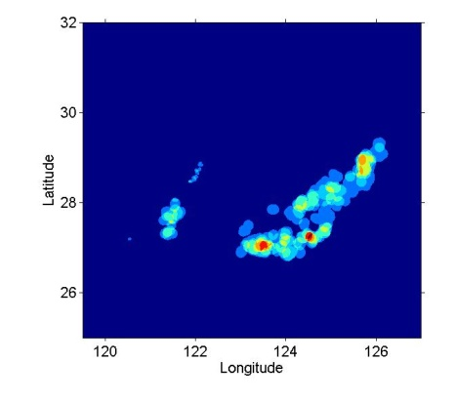
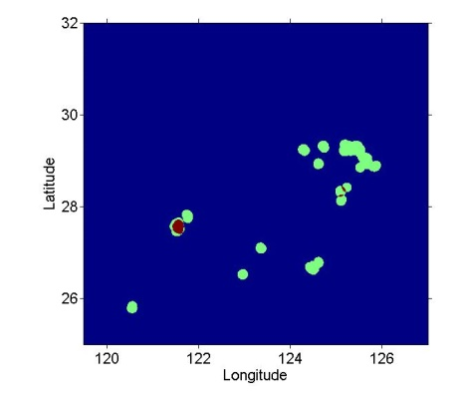
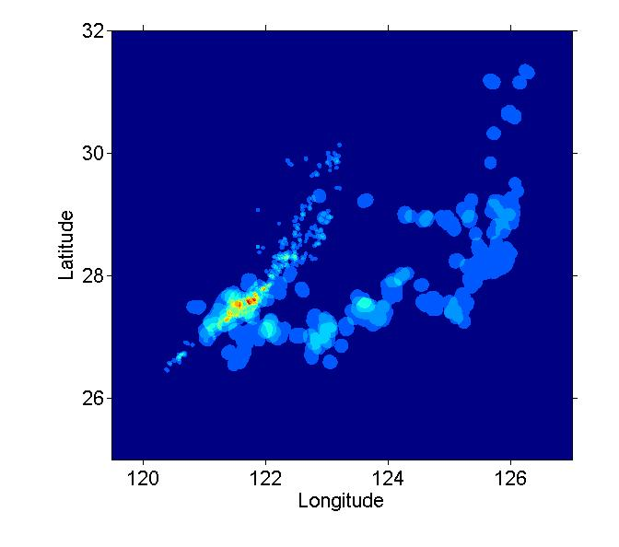
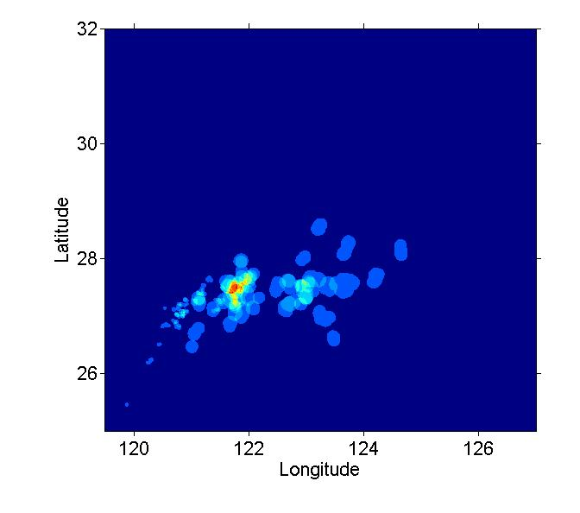
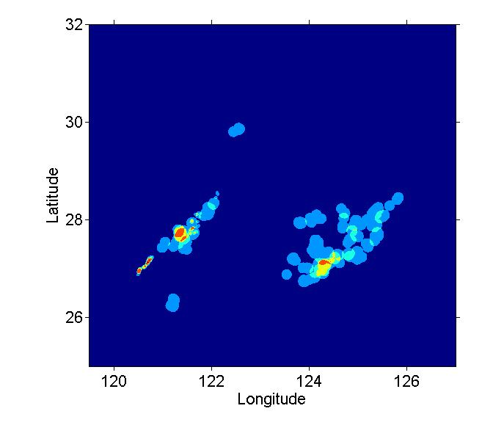
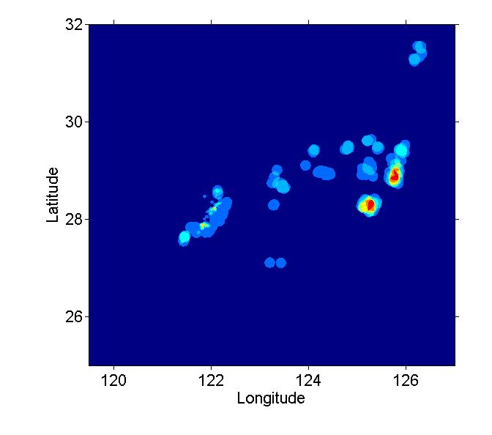
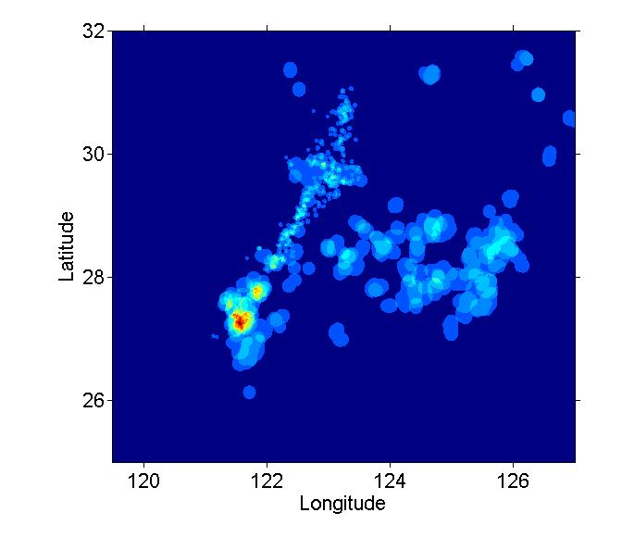
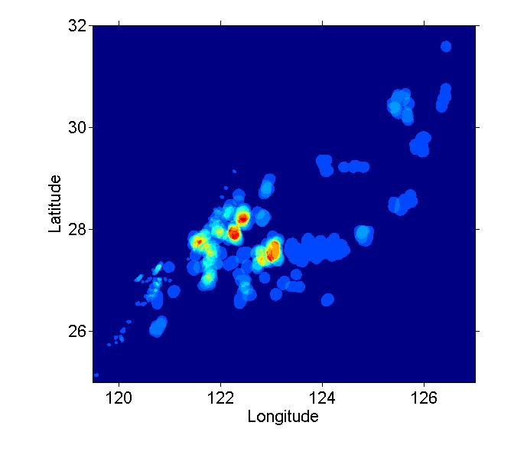

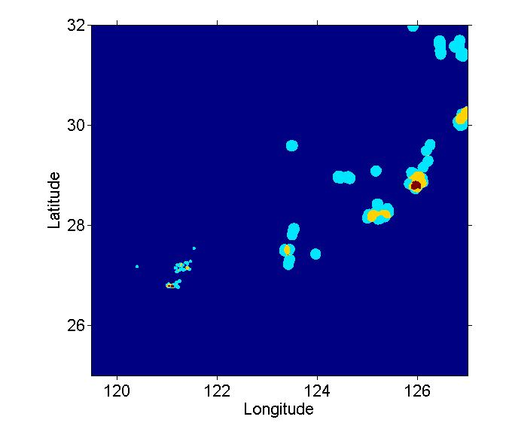
1st Quarter
2st Quarter
3st Quarter
4st Quarter
2014
2015
2016

Slide 21
1st Quarter
2st Quarter
3st Quarter
4st Quarter
2014
2015
2016

